Slide 1
Control Systems Design
Chapter 5

Slide 2
Review
Three steps involved in control system design
Commonly used specifications
Controller configuration
Typical Controllers
Control system design using time-domain method

Slide 3
Outlines
How to design a controller using frequency-domain method;

Slide 4







Controller Design with Frequency-Domain Methods
Performance specifications in frequency-domain
  phase margin or gain margin
  gain or phase crossover frequency
General relations between frequency-domain specifications and time-domain specifications
  the smaller the is, the larger the overshoot is
  the bigger the is, the larger the overshoot is
  the faster a system responds to a unit-step input, the higher the bandwidth is
  the shorter the settling time is, the higher the bandwidth is
  the bigger the gain crossover frequency is, the bigger the bandwidth is

Slide 5
General Guidelines
The magnitude plot should pass through the real axis in the intermediate frequency band and with a slop of -20dB per decade. The pass-through section should have a width of 1 decade;
The low-frequency band should have enough height;
In the high-frequency band, the magnitude plot should decay with an appropriate cutoff rate.

Slide 6

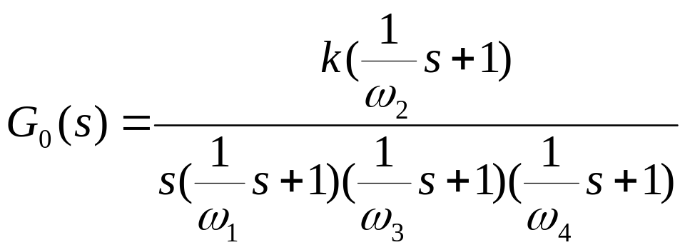

General Guidelines
-20
60
40
-40
20lg
k
20
-20
0dB
1
ω
ω
ω
ω
ω
ω
rad/s
1
2
c
3
4
-20
-40
-40
-60
0
0
ω
ω
ω
ω
ω
rad/s
1
2
3
4
-90
0
-180
0
-270
0

Slide 7


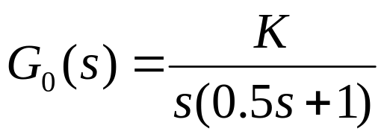
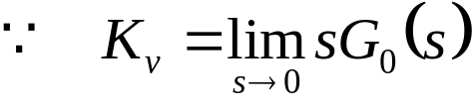

Example - 5.3
Q: the open-loop transfer function of a unit feedback system is shown as follows. Please design a series compensator so that the following performance specifications are satisfied: the ramp-error constant ,
the phase margin
A:
1st step, choose K to satisfy the steady-state error requirement

Slide 8
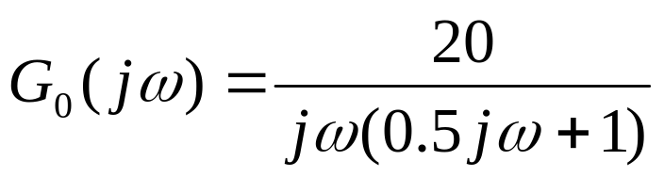
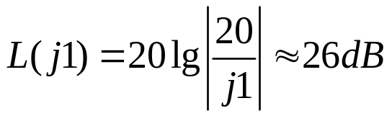


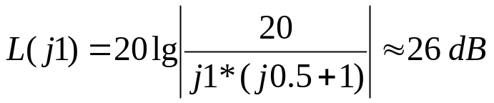

2nd step, sketch the bode plot and check the phase margin:
40
-20
26
20
-40
ω
0dB
0.1
1
2
10
rad/s
-20

Slide 9
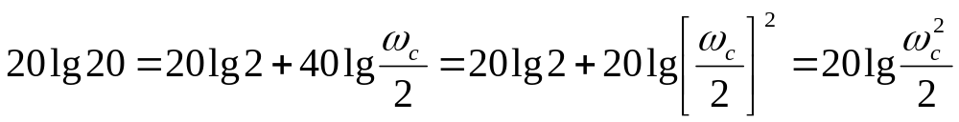
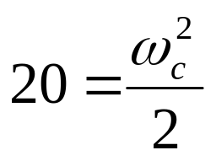
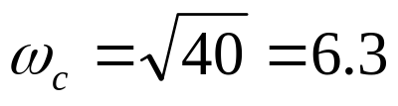
the gain crossover frequency is:
26dB
-20
-40
0dB
ω
1
2
c

Slide 10
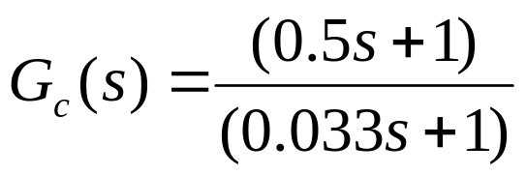

Cancellation method can be used.
The numerator cancels the corner frequency , new corner
frequency is determined through trial-and-error.
40
-20
26
20
0dB
-40
30
0.1
1
2
ω
10
20
ω
rad/s
c
-20

Slide 11
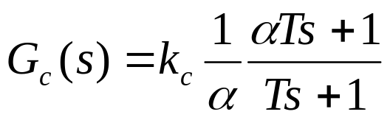

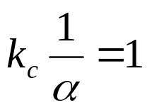

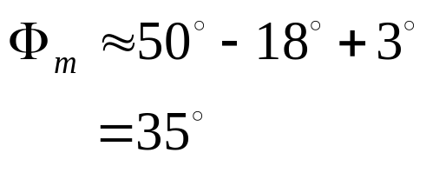
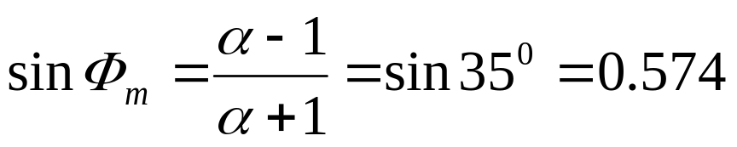

Choose phase-lead controller
set
+20
20lg
α
then
0dB
1
1
ω
rad/s
If the phase margin
α
T
T
Then, the controller
should provide:
0
0
Φ
m
ω
ω
rad/s
m

Slide 12

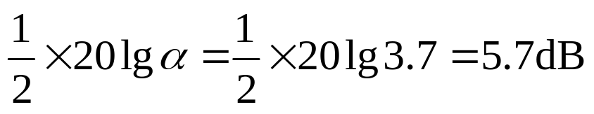
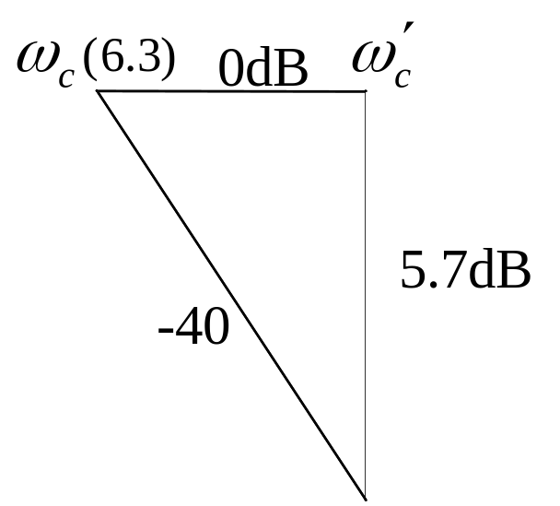

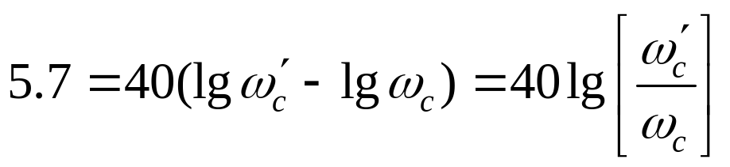
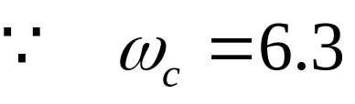
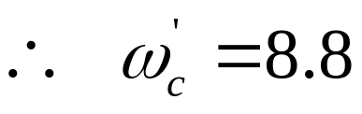
On the magnitude plot, the biggest lift occurs at where the is.
-20
0dB
2
6.3
5.7dB
-20
-40

Slide 13
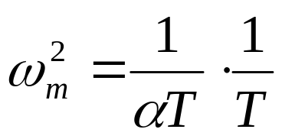
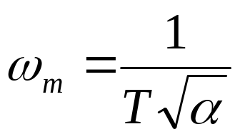
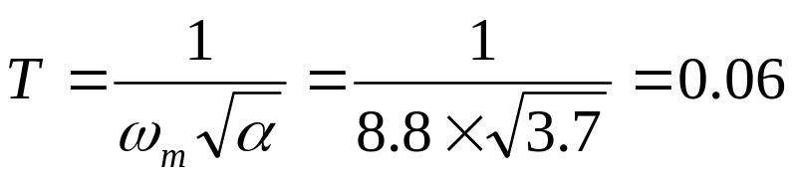

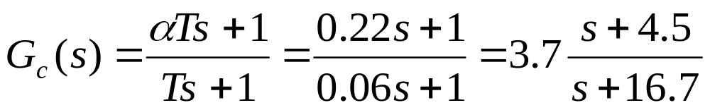
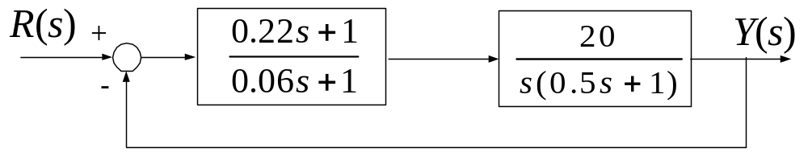

Slide 14
Bode plot of the compensated system:
40
-20
20
-40
0dB
8.8
16.7
ω
rad/s
0.1
1
2
4.5
10
-20
-40
Phase margin of the compensated system:

Slide 15



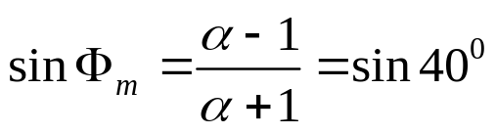

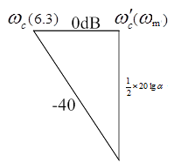
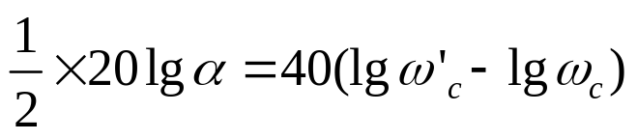

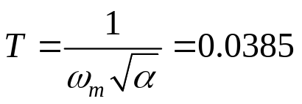

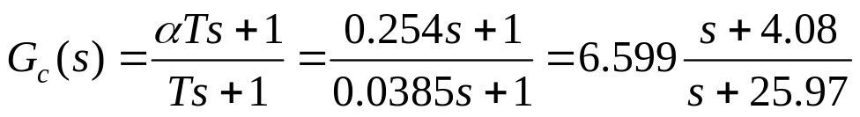
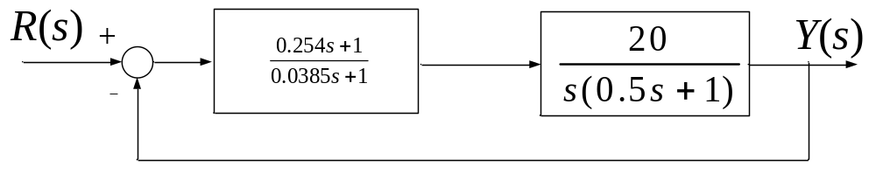
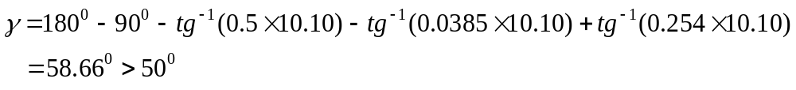
Adjust the design (do not need in the exam of this course)
Go back to which the controller should provide, and increase it
Meet the requirements.

Slide 16



Remarks:
Principle of compensation: make the magnitude plot pass through the real
axis with a slop of -20dB/decade, and keep enough distance away from sections
with other slops. Trial-and-error is usually used at this time.
If and are two corner frequencies of the compensator, then
is where the maximum phase lift is.
40
-20
20
-40
0dB
8.8
16.7
ω
rad/s
0.1
1
2
4.5
10
-20
-40

Slide 17
Matlab Verification
s=tf('s');
k=20;
m=k/(s*(0.5*s+1));
sys=feedback(m,1);
step(sys,’b’);
grid on;
hold on;
m1=((0.254*s+1)/(0.0385*s+1))*k/(s*(0.5*s+1));
sys1=feedback(m1,1);
step(sys1,’g’);
m2=((0.5*s+1)/(0.033*s+1))*k/(s*(0.5*s+1));
sys2=feedback(m2,1);
step(sys2,’r’);

Slide 18
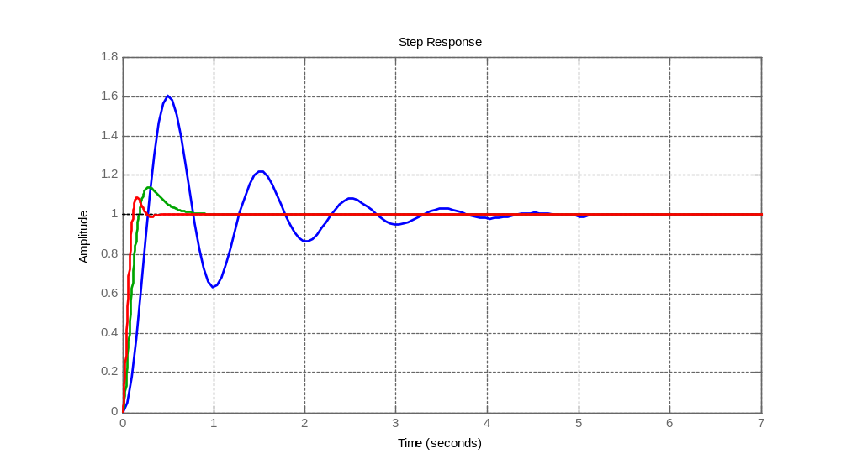
Original System
Phase-lead Controller
Cancellation Controller

Slide 19

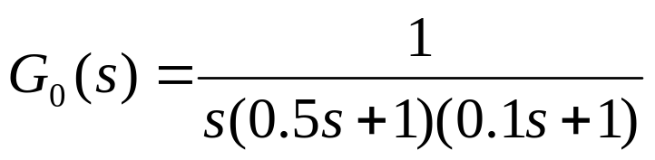



Example - 5.4
Q: the open-loop transfer function of a unit feedback system is shown as follows. Please design a series compensator so that the ramp-error constant
A:
1st step, choose performance specifications of the original system
Low-frequency band:
Corner frequency:

Slide 20


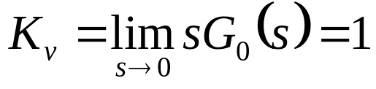
dB
40
20
-20
0dB
2
0.1
1
10
rad/s
-40
-20
-40
-60
Not satisfy the requirement
Low-frequency gain should be increased.

Slide 21
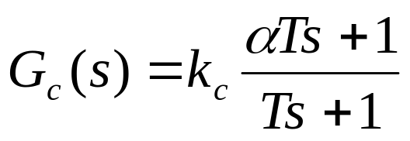
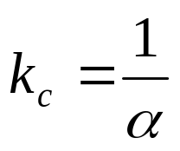

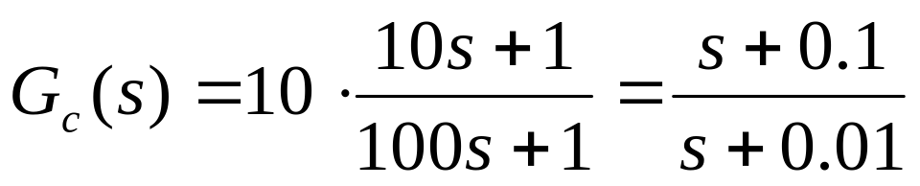
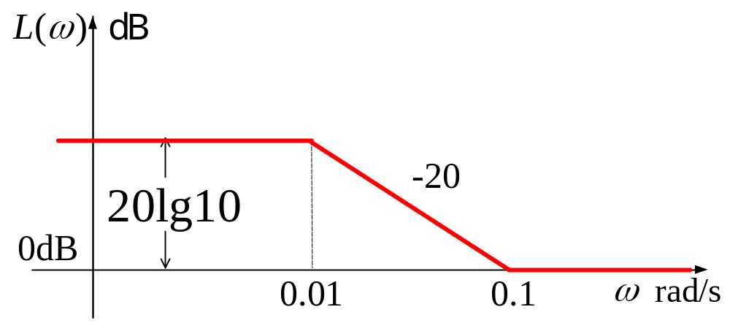
A phase-lag controller is chosen
Considering that the corner frequencies should be 1/5~1/10 of gain
crossover frequency and enough low-frequency gain, the following
parameter is chosen:

Slide 22
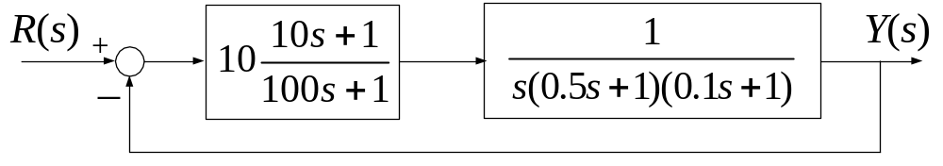


dB
-20
-40
40
20
-20
0dB
0.01
0.1
1
-40
10
rad/s
-20
-60
Solution is not unique!

Slide 23
Time response to unit-step signal
s=tf('s');
k=1;
m=k/(s*(0.5*s+1)*(0.1*s+1));
sys=feedback(m,1);
step(sys,’b’);
grid on ;
hold on;
m1=( (s+0.1)/(s+0.01))*k/(s*(0.55*s+1)*(0.1*s+1));
sys1=feedback(m1,1);
step(sys1,’r’);

Slide 24
Step Response
1.4
1.2
1
0.8
Amplitude
0.6
0.4
0.2
0
0
5
10
15
20
25
30
Time (sec)

Slide 25
Time response to unit-ramp signal
s=tf('s');
m=1/(s*(0.5*s+1)*(0.1*s+1));
sys=feedback(m,1);
t=0:0.1:20;
lsim(sys,’b’,t,t);
grid on;
hold on;
m1=( (s+0.1)/(s+0.01))*1/(s*(0.55*s+1)*(0.1*s+1));
sys1=feedback(m1,1);
lsim(sys1,’r’,t,t);

Slide 26
Linear Simulation Results
20
18
16
14
12
compensated system
Amplitude
10
original system
8
6
4
2
0
0
2
4
6
8
10
12
14
16
18
20
Time (sec)

Slide 27

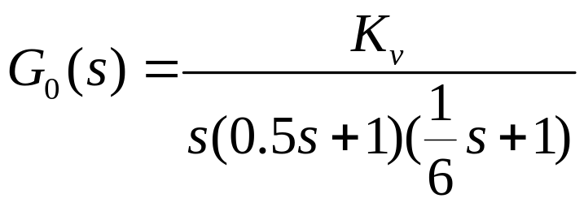

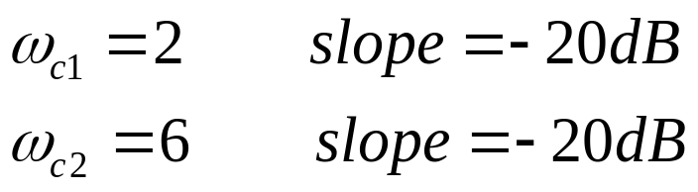
Example - 5.5
Q: the open-loop transfer function of a unit feedback system is shown as follows. Please design a serious compensator so that the following specifications are satisfied:
A:
1st step, check the performance specifications of the original system
Low-frequency band:
Corner frequency:

Slide 28
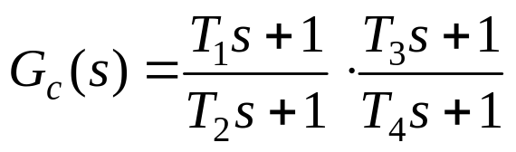










dB
80
-20
60
Lag
Lead
40
-40
-40
20
45.1 dB
-20
13
0dB
-20
0.01
0.1
1
2
6
10
100
rad/s
-20
-40
-60
-40
dB
0dB
rad/s
-20
+20

Slide 29





A lead-lag controller is chosen. Starting from the given gain
crossover frequency determine the parameter values of the
controller.
If the new gain crossover frequency is
choose the corner frequency of the lag block to be:
The other corner frequency of the lag block satisfies:
set
dB
0.7
2
0dB
rad/s
-20
+20

Slide 30
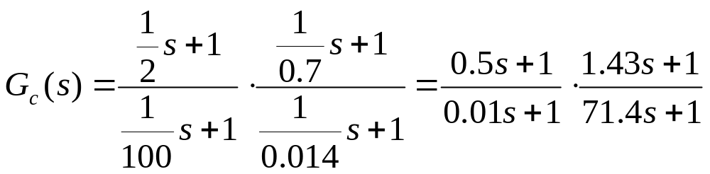
The final controller is:
s=tf('s');
k=180;
m=((0.5*s+0.1)/(0.01*s+1))*((1.43*s+1)/(71.4*s+1))
*k/(s*(0.5*s+1)*(1.6667*s+1));
sys=feedback(m,1);
step(sys,15);
grid on;

Slide 31
Step Response
1.4
1.2
1
0.8
Amplitude
0.6
0.4
0.2
0
0
5
10
15
Time (sec)

Slide 32
dB
80
-20
60
40
-40
-40
20
45.1 dB
-20
13
0dB
-20
0.01
0.1
1
2
6
10
100
rad/s
-20
-40
-60
-40
-60

Slide 33
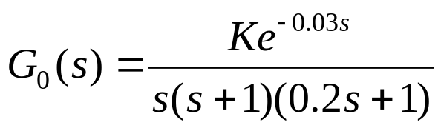

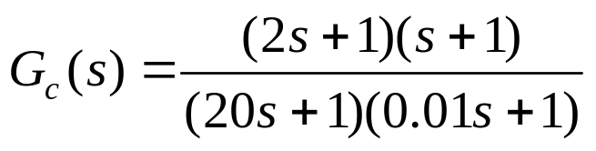


Example - 5.6
The open-loop transfer function of a unit feedback system is shown as follows.
Requirements:
Q:
1. Determine the type of the compensator (phase-lead, phase-lag, or lead-lag controller).
2. If the Lead-Lag controller is applied and shown as follows.
Calculate and ; check the requirements.

Slide 34
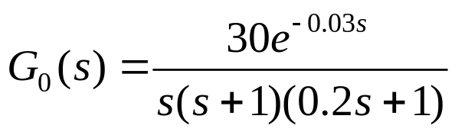
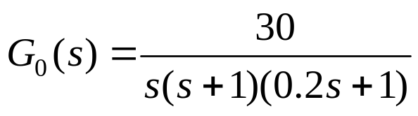


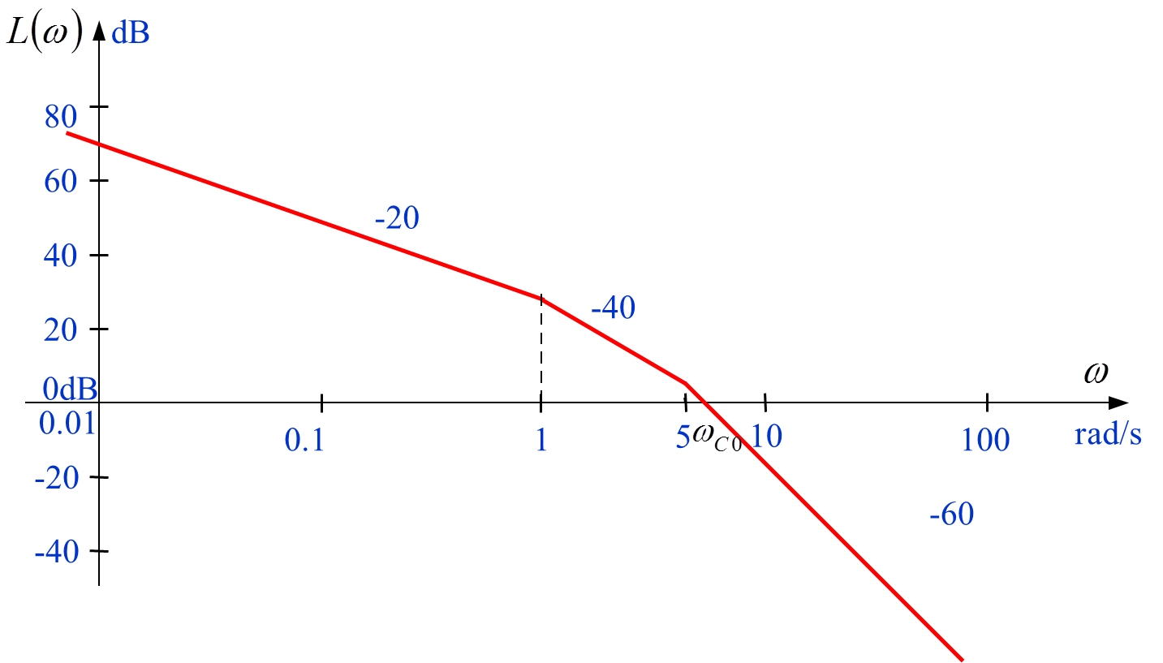

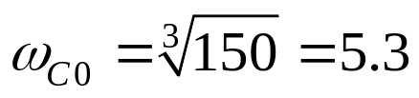
A:
1. K=30, the open loop transfer function is
Its magnitude Bode plot is the same as
Low-frequency band:
Corner frequency:
Notes:
57.3=180/π: rad->o

Slide 35




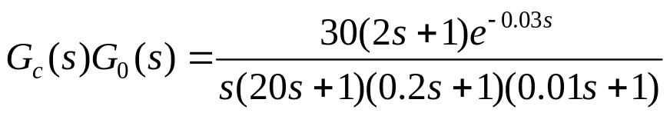
The system is not stable.
If a phase-lead controller is chosen, should be more than 85°！
If a phase-lag controller is chosen，
not considering the phase lag it brings, let
could not meet and at the same time.
So a lead-lag controller is chosen.
2. If the lead-lag controller is applied
The open loop transfer function is
Draw its magnitude plot and calculate.
Notes:
57.3=180/π: rad->o

Slide 36








dB
80
60
-20
Meet all the requirements.
40
-40
-40
20
-20
0dB
0.01
0.05
0.1
0.5
1
5
10
30
100
rad/s
-60
-20
-40
-40
-60
dB
0dB
rad/s
-20
+20

Slide 37



Example - 5.7
The original open-loop transfer function of a minimum-phase system is shown as follows：
The compensated open-loop transfer function is shown as follows：
Q:
1. Find the expression of
and
2. Find the transfer function of the compensator
3. Calculate the phase margin and gain margin of
dB
-20
40
-40
-40
20
-20
0
-20
7
0.015
0.1
0.7
1
2
10
-20
1.5
-40
0.15
-60

Slide 38









1. Find the expression of
and
dB
-20
40
20
-40
0.015
0.1
1
2
10
-20
-60
For
, there are an integration block and two inertia blocks
（1）
（2）
Notes:
57.3=180/π: rad->o

Slide 39



1. Find the expression of
and
dB
-20
40
-40
-40
20
-20
0
-20
7
0.015
0.1
0.7
1
2
10
-20
1.5
-40
0.15
-60
(1)
For
, the low-frequency section is the same as
So,
has an integration block and same
(2)
Notes:
57.3=180/π: rad->o

Slide 40

1. Find the expression of
and
dB
-20
40
-40
-40
20
-20
0
-20
7
0.015
0.1
0.7
1
2
10
-20
1.5
-40
0.15
-60
Notes:
57.3=180/π: rad->o

Slide 41


2. Find the transfer function of the compensator
In order to find the transfer function of the compensator
We use
Thus, transfer function of the compensator is
This is a Lead-Lag compensator
Notes:
57.3=180/π: rad->o

Slide 42



3. Calculate the phase margin and gain margin of
dB
40
-40
20
-20
0
-20
7
0.015
0.1
0.7
1
2
10
-20
1.5
-40
0.15
-60
Phase margin

Slide 43



3. Calculate the phase margin and gain margin of
Let
We get
(by try and error)
Gain margin

Slide 44
Wrap-up
How to design a controller using time-domain method;
How to design a controller using frequency-domain method;

Slide 45

投票
最多可选1项
Review questions
If a PD controller is so designed that the characteristic-equation roots have better damping than the original system, the maximum overshoot of the system is always reduced
A
T
B
F
提交

Slide 46
Review questions
If a PD controller is so designed that the characteristic-equation roots have better damping than the original system, the maximum overshoot of the system is always reduced
(T) (F)

Slide 47
投票
最多可选1项
Review questions
A system compensated with a PD controller is usually more robust than a system compensated with a PI controller.
A
T
B
F
提交

Slide 48
Review questions
A system compensated with a PD controller is usually more robust than a system compensated with a PI controller.
(T) (F)

Slide 49
投票
最多可选1项
Review questions
The maximum phase that is available from single-stage phase-lead control is 90 degree.
A
T
B
F
提交

Slide 50
Review questions
The maximum phase that is available from single-stage phase-lead control is 90 degree.
(T) (F)

Slide 51
投票
最多可选1项
Review questions
The design objective of the phase-lead controller is to place the maximum phase lead at the new gain-crossover frequency.
A
T
B
F
提交

Slide 52
Review questions
The design objective of the phase-lead controller is to place the maximum phase lead at the new gain-crossover frequency.
(T) (F)

Slide 53
State Feedback Control Systems
Chapter 6

Slide 54
Review of the Last Chapter
Three steps involved in control system design
Control system configuration
Typical controller types
Parameter value determination
Design controller using time-domain method
Design controller using frequency-domain method

Slide 55
Introduction to this Chapter
Controllability concept and condition
Observability concept and condition
Controllability & observability versus zero-pole cancellation
Controllability & observability decomposing
State-feedback and pole-placement design
Observer and state-feedback control system with an observer

Slide 56
Outlines to this Class
Definition of controllability
Controllability condition

Slide 57
Advantages of State Equation
Be able to depict complex systems
Be able to provide internal information of a control system
When certain conditions are satisfied, the poles of a system can be arbitrarily placed so that desirable performance can be obtained

Slide 58
Controllability
Definition:
A process is said to be completely controllable if every state variable
of the process can be controlled to reach a certain objective in finite
time by some unconstrained control.
Intuitively:
If any one of the state variables is independent of the control, there
would be no way of driving this particular state variable to a desired
state in finite time by means of a control effort. Therefore, the particular
state is said to be uncontrollable.

Slide 59



Examples of Uncontrollable
Example 6.1
Find the given system is controllable or uncontrollable.
x
controllable
subspace
2
x
1
is independent of the control

Slide 60

Examples of Uncontrollable
Example 6.2
Find the given system is controllable or uncontrollable.
x
x
(
t
)=
x
(
t
)
2
1
2
x
1
controllable
subspace

Slide 61




Controllability Condition
For the system described by the given state equation
to be completely controllable, it is necessary and sufficient that the
following controllability matrix S has a rank of n:

Slide 62





Controllability Example
Example 6.3
Find the given system is controllable or uncontrollable.
A:
system is controllable

Slide 63






Controllability Example
Example 6.4
Find the given system is controllable or uncontrollable.
A:
system is uncontrollable

Slide 64






Proof of the Controllability Condition
To prove the controllability of a system, we need to demonstrate
that by some ways we can make the system reach any arbitrary
point. For a linear time-invariant system, we can always set the coordinate
origin to be the select destination point. Therefore, we just need to prove
that the system can be driven to the origin by certain control in finite time.
For a LTI system:
its state response is:
Assume:
Prove does exist!

Slide 65



Cayley-Hamilton Theorem
For a n×n square matrix A, it must satisfy its own characteristic equation.
If:
Then:
Corollary 1:
For a n×n square matrix A, it’s nth or higher order power
can be expressed by the linear combination of its n-1 lower
order powers.

Slide 66






For example:
n＝2

Slide 67






Corollary 2: matrix exponential function can be expressed
by the linear combination of the n powers, from 0 to n-1th order,
of square matrix A.
where
Notes:
阶乘 factorial

Slide 68




Back to the proof:
Substitute
into the above equation
where

Slide 69




For a single input system:
There are n unknown variables and n equations.
If , the inverse of S exists, the equation has unique solution,
and the system is controllable.
If , the inverse of S does not exist,we can not find a unique
solution through the above equation.

Slide 70

For a multiple-input system, assume there are p inputs:
There are np unknown variables and n equations.
If , the equation has infinite solutions, and the system is controllable.
If ,we can not find a unique solution through the above
equation.

Slide 71
Choosing different state variable set will lead to different state equations.
One form of state equation of a LTI system can be transformed into another one by non-singular linear-transformation.
Question:
Will non-singular linear-transformation change the controllability of a LTI system?

Slide 72








Non-Singular Linear Transformation
The non-singular linear transformation is:

Slide 73







System Controllability after Linear Transformation
For the original system (A,B):
For the system after transformation (A’, B’):
Controllability does not change
after non-singular linear transformation

Slide 74

Controllability Condition 2
For a linear time-invariant system with distinct eigenvalues to be
controllable, it is necessary and sufficient that the B matrix in its
diagonal canonical form does not have a row with all elements to
be zero.
For example:
A single input system
if B does not have any zero element, the system is controllable.

Slide 75








if
then

Slide 76





Example 6.5:
controllable
Example 6.6:
uncontrollable

Slide 77





Controllability Canonical Form
SISO:
Systems in controllability canonical form must be controllable.

Slide 78

Wrap-up
Definition of controllability
Controllability condition and its demonstration
Controllability canonical form and its controllability

Slide 79
Assignment Review
page_72_ex10_ex11

Slide 80
Assignment
Page 127
  1 ，2
Page 128
  7，8
Requirement
Sketch Bode plots for the original and modified system;
Calculate the system performance indices after modification;
Simulate the system before and after modification using Matlab.
Page 149-150
1，(2)、(4)
2，(1)

